Slide 1

Section 0. Outline of workshop and introductions
Section 1. Starting your research project:
What makes a research question viable?

Slide 2
Outline
Introductions
Who are we?
What is this course?
Day 1
Section 1. Starting Your Research Project
Section 2. Practical Tips for Writing Your Applied Paper
Section 3. Optional Q&A Session for Graduate Students and Job Market Candidates
Day 2
Section 4. The Publication Process
Section 5. Refereeing
Section 6. Conferences and Networking
Section 7. Ask the Editor!
Section 8. Optional Session for Graduate Students and Job Market Candidates

Slide 3
Who are we?
Mark Anderson (Professor of Economics, Montana State University) and Dan Rees (Professor of Economics, Universidad Carlos III de Madrid)
Applied microeconomists with interests in health and economic history
Users of well-defined natural experiments and methods such as DD and IV
Passionate about the research process and the crafting of a research paper (it is an art and this is our craft!)
Together, we have written on topics such as…
The occupational licensing of midwives and maternal mortality at the turn of the 20th century
The hiring of municipal milk inspectors and foodborne disease mortality in the late 1800s
Hospital desegregation during the 1960s and the black-white infant mortality gap
Marijuana legalization (too many papers on this topic…)

Slide 4
What is this course?
A hidden curriculum
What we wish we would have learned as graduate students/asst. profs. on…
Research process
Writing papers
Publishing
Other stuff (refereeing, conferences, etc.)
There is a template for doing good applied research, and we hope to share that with you
Two 4-hour days
Series of 10- to 30-minute lectures
Plenty of time set aside for Q&A in between and after each topic
We will do our best to stick to the schedule but may improvise slightly

Slide 5
Starting Your Research Project
What makes a research question viable?
The three hurdles:
(i) Is it interesting/important/policy relevant? How do you figure this out?
(ii) Are you filling a clearly defined gap in the literature? How do you figure this out?
(iii) Are the data available? Does a well-defined natural experiment exist?

Slide 6
Hurdle #1. Is it interesting/important/policy relevant?
How do I know if my idea is interesting?
I’ve often had ideas that I thought were interesting…but no one else did.
Pitch your idea to as many people who will listen, especially other economists who you know will be critical
Try-to-kill-my-idea sessions are particularly helpful
Pitch your idea to non-economists as well. This is particularly important for applied (as opposed to theoretical) researchers.
I still pitch my ideas to my father (and he is a retired dentist)
My wife hates all of my ideas…
If it is interesting, does that mean it is “important”?
Yes! Which leads into…
Does my idea have to be policy relevant?
It depends on the question and context
Take, for instance, the U.S. mortality transition…

Slide 7
Might there be some current policy relevance to explaining what caused the profound declines in U.S. mortality at the turn of the 20th century?
Sure, maybe. But, trying to better understand what has been called “one of the most significant developments in the history of human welfare” is interesting in and of itself!
Don’t force a project to be policy relevant if it isn’t or, more importantly, doesn’t need to be

Slide 8
Hurdle #2. Are you filling a clearly defined gap in the literature?
Before you do anything else, become an expert of the relevant literature. After that, it will all fall into place.
How do I do this?
I spend the initial weeks on a project doing nothing but combing carefully through the literature
For each project, I create a literature-review binder
Start with econ-specific search engines (e.g., JSTOR, Econ Lit, NBER WP, etc.) before doing more general searches on engines such as Google Scholar
Sort by theoretical vs. empirical
Sort by how well the papers published
Sort empirical papers by the credibility or type of research design
Cross-sectional vs. panel
IV vs. DD vs. RD
After you do this, you will know exactly how you are building on existing studies.
Three months into a project, you do not want to learn of a paper that has already done precisely what you are doing…

Slide 9


Slide 10
Hurdle #3. Are the data available? Does a well-defined natural experiment exist?
This is where I end up killing probably 80% or more of my ideas. Do not assume the data exist…get on this yesterday!
Sometimes the data exist, but can take very long to collect…again, get on this yesterday!
Data on X and Y are available, but I do not have a well-defined natural experiment to exploit. Should I dump the idea?
As a grad student trying to write your JMP, you should probably dump it.
As a junior prof. trying to get tenure, you should probably dump it.
You may be able to pivot and target a non-econ journal, but this takes time you could spend elsewhere
You can become a structural labor economist, but then you won’t have any friends. Just kidding!

Slide 11
Hurdle #3. Are the data available? Does a well-defined natural experiment exist?
Should I start with a hypothesis of interest and then try to identify a natural experiment? Or, should I be on the lookout for a natural experiment, and then come up with my question of interest?
Some “old-school” folks think the pure form of research is to do the former.
Impractical
Risk missing out on a lot of good topics
Have your research/natural experiment radar on at all times…one does not know where an inspiration will come from.
Mark and Dan’s trip to the Smithsonian Museum of American History

Slide 12
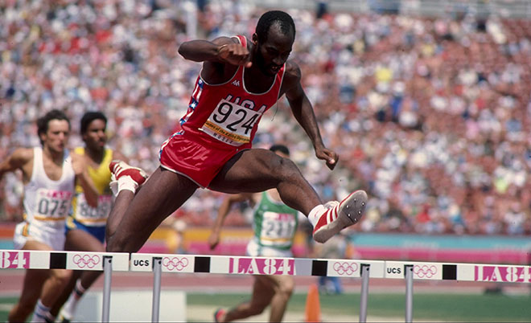

If you can get over these 3 hurdles, you are off to the races!
If you can’t, get back up, and go back to the drawing board.
Edwin Moses, the greatest 400m hurdler of all time

Slide 13
Q&A (≈ 5 minutes)

Slide 14
Section 1. Starting your research project:
When to cut the cord

Slide 15
When to cut the cord on a project
Conditional on clearing the 3 hurdles, how do I know when to give up on a project? When do I call it quits?
As a graduate student trying to come up with a great JMP or a jr. prof. trying to get tenure, this can be a make-it or break-it decision.
In applied microeconomic research, one is generally confronted with this question when…
1.) you are estimating a null result
2.) you cannot satisfactorily pin down mechanisms
3.) opportunity costs go up because a better project comes along

Slide 16
The Null Result
Zero is a number too! But, is it always interesting?
Suppose one estimated no effect of minimum wage hike on unemployment…this would be an interesting and policy relevant zero.
What about the relationship between prenatal exposure to the Super Bowl and low birth weight (Duncan et al. 2017, JHR) or the relationship between minimum wages and traffic fatalities (Adams et al. 2017, RESTAT)?
These are examples of topics that are probably only interesting if you find an effect.
High risk-high reward project.
One would not want to make one of these projects their job market paper if a null was found.
A null effect would not publish well.
Does this cause a type of file-drawer bias? Sure. But, one also needs to be practical when weighing the trade-offs between which projects to pursue and which ones to quit.
Zero is a number too, but only if it is precise!
Big difference between trying to pitch a tight vs. noisy zero.
If my 95% CI contains large values on either side of zero, then we do not learn much.

Slide 17
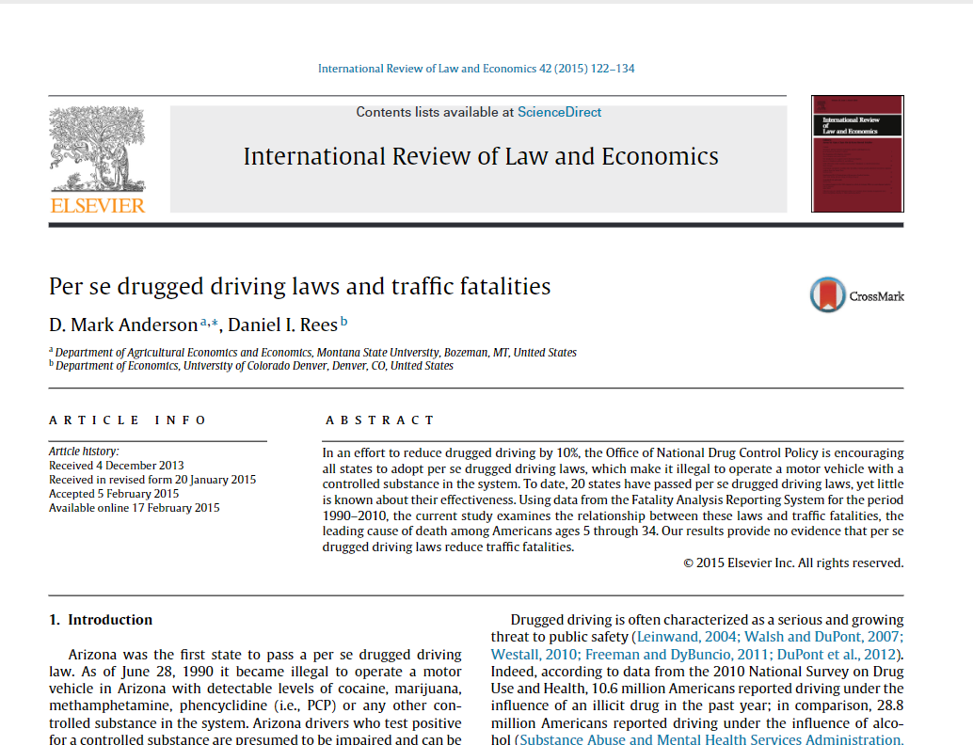
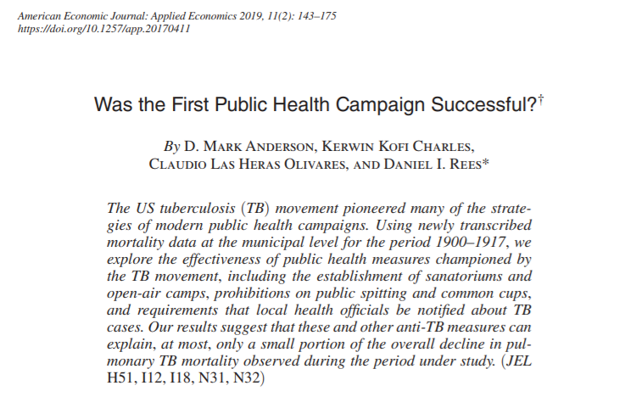
The Null Result
Imprecise zeros, on the other hand…
Papers with precise zeros can publish well
If my null estimate is interesting/important/policy relevant and measured with precision, proceed with the project.
However, also know that the burden of proof is not the same as if you were finding an effect. Dan will talk more on how to frame/pitch a precise zero later in the workshop.

Slide 18
Identifying Mechanisms
Suppose you are able to exploit a well-defined natural experiment, but you cannot identify the mechanism through which your effect works.
Is this always a death sentence for a paper?
No, not necessarily! It depends on the topic…so, let’s take a look at some examples.
Medical marijuana laws (MMLs) → traffic fatalities (Anderson et al. 2013, J of Law and Econ)
MMLs associated with 8-11 percent decrease in traffic fatalities
Effect is driven by alcohol-related crashes
Also evidence that beer sales and self-reports of binge drinking fall
Had this paper not been able to shed light on the mechanism through which MMLs work, it probably would not have published very well. It would have made for an ok, but not great, job market paper.

Slide 19
Identifying Mechanisms
Military deployments → crime (Anderson and Rees 2015, J of Law and Econ)
Increases in the number of never-deployed combat brigades at Fort Carson, CO are associated with more assaults, murders, rapes, and robberies
In contrast, estimates of the relationship between previously deployed combat brigades and violent crime are generally small and statistically insignificant
Never-deployed units represent a greater threat to public safety…but why?
Ultimately, we could not shed much light on the “why”
But, because our results ran so counter to common perception, the results were interesting and the paper published well. Here, we did not need to pin down the mechanism(s).
Medical marijuana laws (MMLs) → suicide (Anderson et al. 2014, American J of Public Health)
MMLs associated with reductions in suicides among young adult males in the United States
Policy relevant? Yes.
Of interest to a general economics audience without being able to say “why” suicides fell? No, probably not.
Ceiling would likely be a third-rate journal in health economics (or worse).
Without being able to identify the mechanism through which this effect works, this topic would not represent a great job market paper.
Recommendation: Move on or pivot and write up for a non-economics journal
A good econ journal is not going to publish this paper, but the flagship journal in public health might!

Slide 20
Identifying Mechanisms
Try to gauge early on in a project whether you will be able to address underlying mechanisms.
You might even want to consider this hurdle #4.
Try to gauge early on in a project just how crucial it will be to address underlying mechanisms.
If you end up sinking a lot of time into a project and cannot address mechanisms in a manner that would satisfy economists, you can pivot and write up for a non-economics journal (more on this in our next section)

Slide 21
Q&A (≈ 5 minutes)

Slide 22
Section 1. Starting your research project:
Managing your research projects

Slide 23
Managing your research projects
Allocating your effort
As a graduate student
The goal is a top-notch JMP. Your efforts can be more concentrated as a graduate student, as opposed to a junior professor trying to get tenure.
That said, do not underestimate the signaling benefit of a publication that is a non-JMP.
For those of you graduating from non-top-20 (or so) programs, this can be really important.
I received my Ph.D. from a top-50 school (U. of Washington) and it was made very clear to me that having a good publication and RR was vital to obtaining interviews
At Montana State University, we have interviewed grad students from lower-ranked departments solely because they had a strong publication on their record
Do not feel like you need to be working on a dozen papers as a graduate student.
Takes time away from JMP
Sends a quantity (as opposed to quality) signal, which is not always a good thing

Slide 24
Managing your research projects
Allocating your effort
As a junior prof.
The goal should be to have a portfolio of projects at different phases
(i) At any given time, you should have one to two projects that are your main focus
I cannot manage more than this, but others can.
(ii) As you progress through your tenure-track, always try to have at least a few papers under review or at the RR stage
(iii) When your papers in (i) are submitted, make sure you already have another project (or two or three) where data collection efforts are already under way.
If you’re lucky enough to have RA resources, this is where I generally spend them.
If you are going into (or are already in) academia, figure out the tenure requirements at your department as early as possible! Preferably, before you even arrive.
Helpful advice that was given to me: “You’re in an agricultural economics department, so do not forget that quantity matters a lot.”

Slide 25
Managing your research projects
Targeting economics journals early in the research process
A question I am often asked, “Where should I send paper X?”
If you become a master of the specific literature (as we discussed earlier), the set of relevant journals will be clear early on
In Section 4 of this workshop, we will discuss this in detail. Stay tuned…
When to target a non-economics journal
You need to pivot because…
Estimates are correlations only
You cannot identify mechanisms
You just don’t have enough “meat” for a full-length paper
You need a mental health break!

Slide 26
Managing your research projects
Every summer I take a few weeks off from the grind of writing econ papers. During this time, I write a paper up for a medical journal.
It’s fun!
You learn how to write for a different audience, and this human capital is transferable. I have become a better writer because I try to write for different audiences
Writing a paper for a non-economics journal often takes much less time
Medical journals have word limits around 3,000-3,500 and table/figure limits around 4-5.
Nearly all good medical journals also have “research letter” options, which have word limits < 1,000 words and table/figure limits around 1-2. Only a few of the good economics journals have “letter” or “note” options.
Turnaround is much faster at medical journals (< 1 month)
But, keep in mind that non-econ publications do not “count” as much if you are on the economics job market or are employed in an economics department
You need to carefully weigh the tradeoffs of pursuing these pubs vs. simply quitting (or not starting) a project altogether.

Slide 27
Q&A (≈ 10 minutes) + Break (≈ 5 minutes)

